Slide 1

POWER BI REINFORCEMENT
SUCHANTH B
04/03/2025

Slide 2
Agenda
INTRODUCTION TO POWER BI
DATASETS AND ATTRIBUTES
DATA CLEANING AND TRANSFORMATION
DAX FUNCTIONS IN POWERBI
DASHBOARDS
KEY INSIGHTS AND CONCLUSION

Slide 3
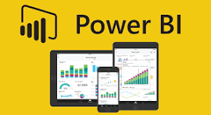
INTRODUCTION TO POWERBI:
Microsoft Power BI is a business analytics service that helps users visualize and analyze data. It's used to create insights and reports that help businesses make better decisions.
Monitor business health , product health, or marketing campaign health.
Create visuals like graph, charts and reports for insights

Slide 4
Describe the datAsetS

Slide 5

The given dataset is a Laptop Price Detection Analysis. In this dataset is used to customer reviewing and rating the laptop brand and model under the range of the price value.
The attributes in the dataset includes are:
Laptop _ brand, laptop _ model, processor _ brand, processor _ model, weight, battery, customer ratings, customer reviews , price, Bluetooth availability, region of sales in laptop
Identifying which brands or models offer the best value for money can help optimize marketing strategies.

Slide 6
DATA CLEANING AND TRANSFORMATION

Slide 7
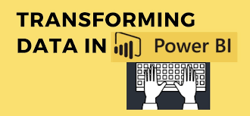

DATA CLEANING AND TRANSFORMATION
From the dataset is used to transform data in power query editor. In the power query editor remove the duplicates values in the laptop _ model and laptop _ brand.
Using Conditional column in add column tab give the condition for laptop_ brand and laptop _model is used to give the proper brand and correct model name for the laptop _ brand.
Replace the availability of a laptop as true as Yes and false as No
Change the date type format for the weight column in whole number to decimal number.
Add a text from the ram _ size column 22 as 22 GB

Slide 8
DAX FUNCTIONS USED IN POWER BI

Slide 9

DAX FUNCTIONS USED IN POWER BI
AVERAGE - This function computes the average of the values contained in the provided column as Input.
DISTINCTCOUNT - This function only accepts as count the unique laptop _ brands
SUM – It is used to total sales or price from the given dataset.
MIN – It is used to give minimum values in the dataset.(customer _ rating or reviews)
MAX- It is used to give maximum values in the dataset.
CALCULATE -Evaluates an expression in a modified filter context.
PREVIOUSYEAR – It is used to calculate the previous years sales under the laptop _brand or prices

Slide 10
Delivering with confidence
DASHBOARD IN POWERBI

Slide 11
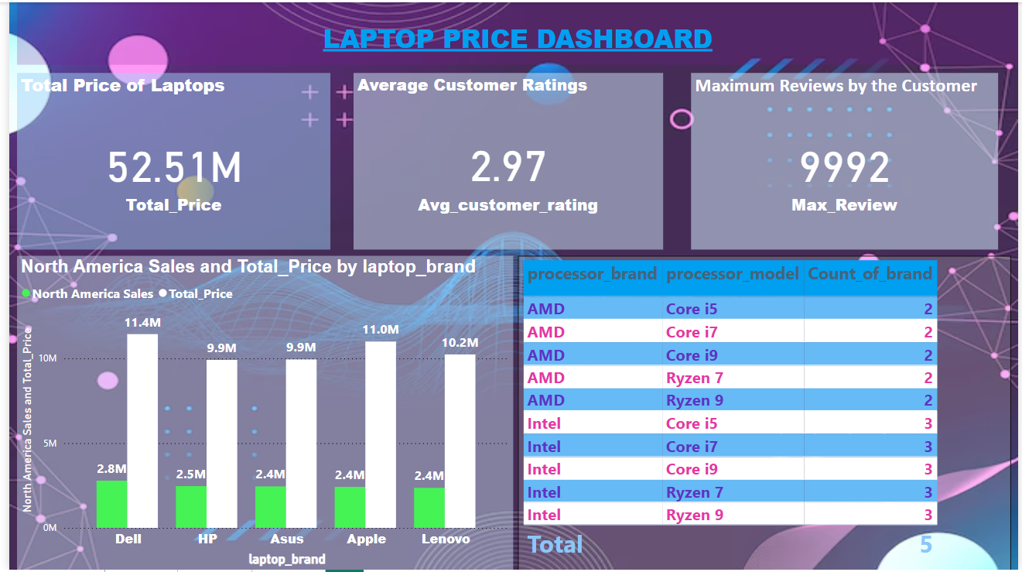

Slide 12
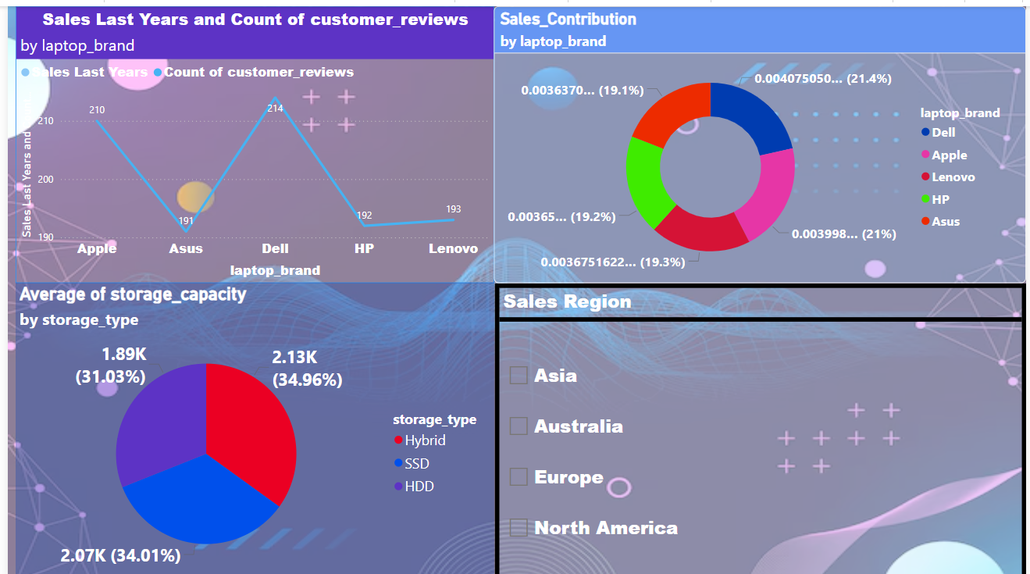

Slide 13
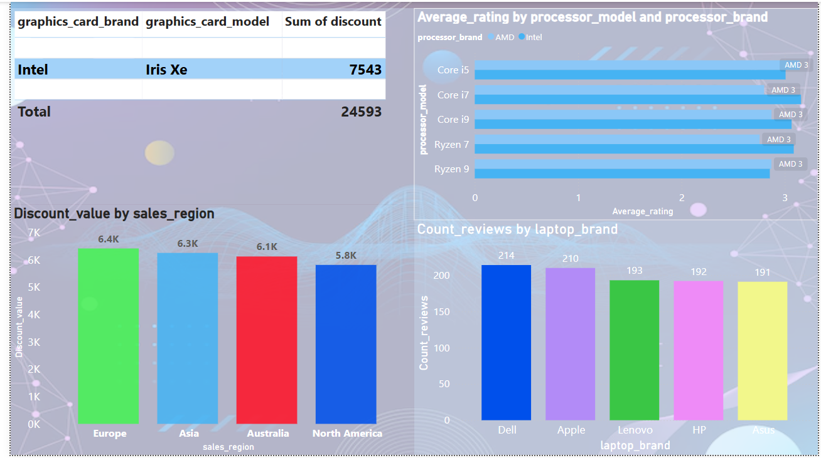

Slide 14
KEY INSIGHTS AND CONCLUSIONS:
Identifying which brands or models offer the best value for money can help optimize marketing strategies.
Analyzing customer ratings and reviews can help identify top-performing models.
Some models have high ratings with thousands of reviews, indicating customer satisfaction.
Availability status indicates which models are currently in stock.
Focus on marketing laptops with high customer ratings and positive reviews.

Slide 15


